Slide 1
Instance Based Learning (KNN)
Dr. Sifat Momen

Slide 2






Nearest Neighbor Classifiers
Basic idea:
If it walks like a duck, looks like a duck, quacks like a duck, then it’s probably a duck
Compute Distance
Test Record
Training Records
Choose k of the “nearest” records

Slide 3
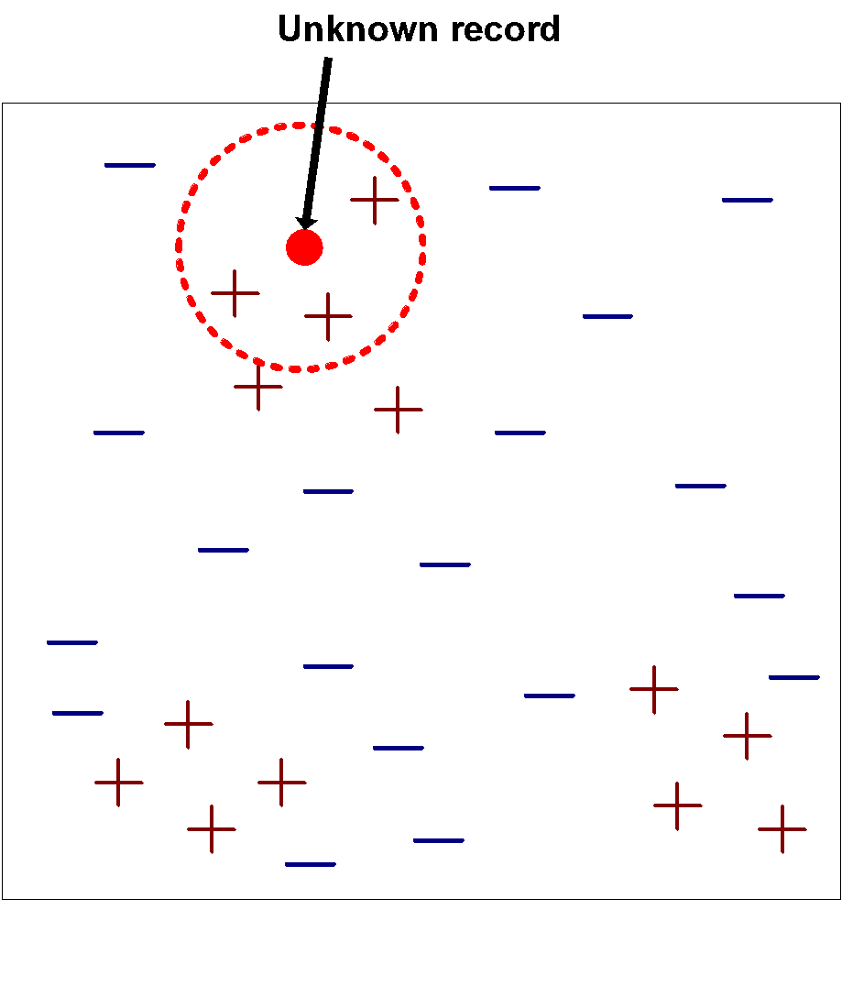
Nearest-Neighbor Classifiers
Requires the following:
A set of labeled records
Proximity metric to compute distance/similarity between a pair of records
e.g., Euclidean distance
The value of k, the number of nearest neighbors to retrieve
A method for using class labels of K nearest neighbors to determine the class label of unknown record (e.g., by taking majority vote)

Slide 4
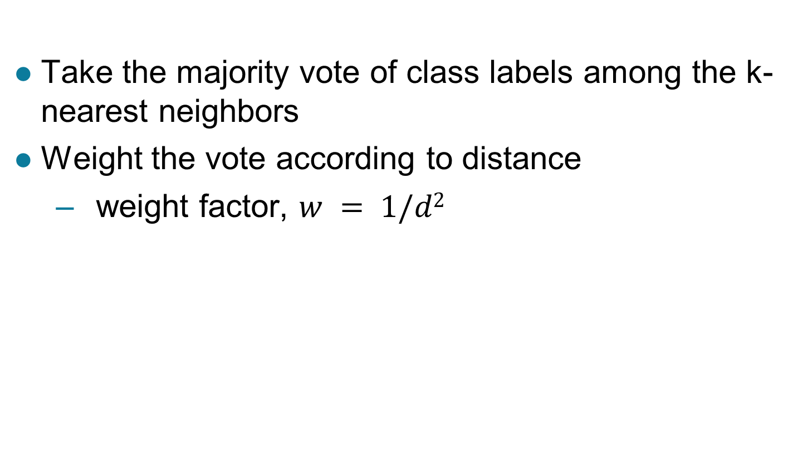
How to Determine the class label of a Test Sample?

Slide 5
Query Types
Exact match query: Asks for the object(s) whose key matches query key exactly.
Range query: Asks for the objects whose key lies in a specified query range (interval).
Nearest-neighbor query: Asks for the objects whose key is “close” to query key.

Slide 6
Exact Match Query
Suppose that we store employee records in a database:
ID Name Age Salary #Children
Example:
key=ID: retrieve the record with ID=12345

Slide 7
Range Query
Example:
key=Age: retrieve all records satisfying
20 < Age < 50
key= #Children: retrieve all records satisfying
1 < #Children < 4
ID Name Age Salary #Children

Slide 8
Nearest-Neighbor(s) (NN) Query
Example:
key=Salary: retrieve the employee whose salary is closest to $50,000 (i.e., 1-NN).
key=Age: retrieve the 5 employees whose age is closest to 40 (i.e., k-NN, k=5).
ID Name Age Salary #Children

Slide 9
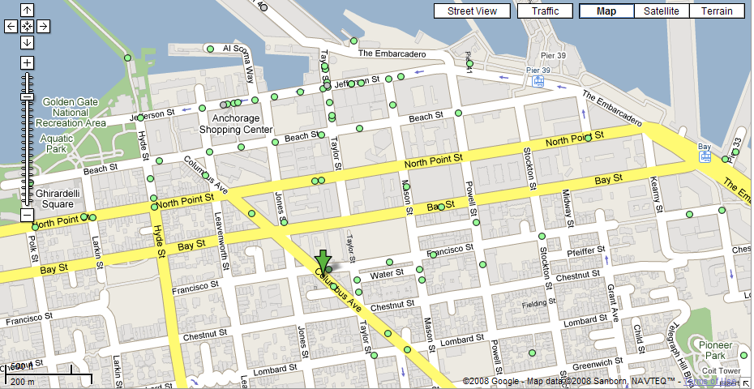
Nearest Neighbor(s) Query
What is the closest restaurant to my hotel?

Slide 10
Nearest Neighbor(s) Query (cont’d)
Find the 4 closest restaurants to my hotel

Slide 11
Multi-dimensional Query
In practice, queries might involve multi-dimensional keys.
key=(Name, Age): retrieve all records with
Name=“George” and “50 <= Age <= 70”
ID Name Age Salary #Children

Slide 12
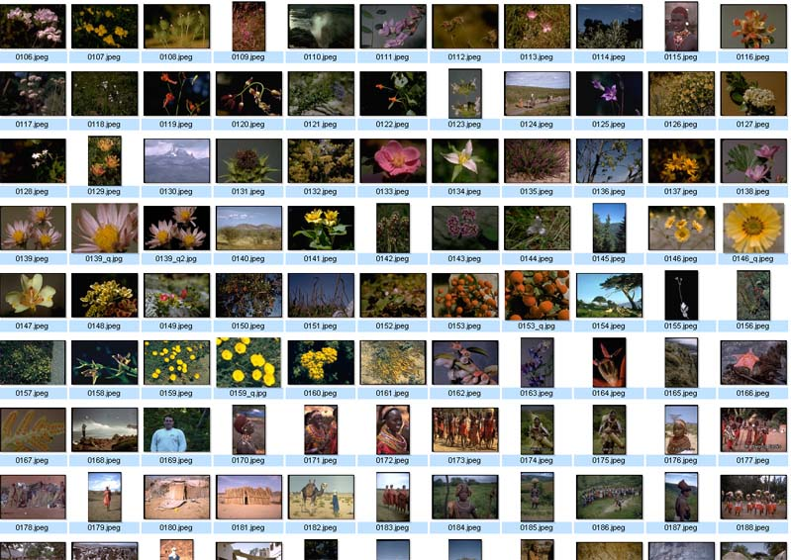
Nearest Neighbor Query in High Dimensions
Very important and practical problem!
Image retrieval
find N closest
matches (i.e., N
nearest neighbors)
(f₁,f₂, .., f_{k})

Slide 13
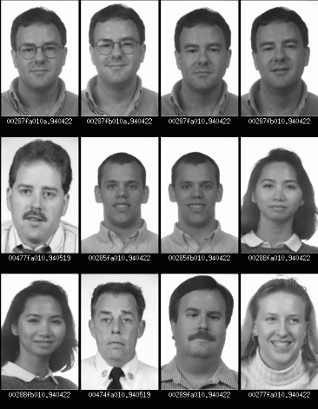
Nearest Neighbor Query in High Dimensions
Face recognition
find closest match
(i.e., nearest neighbor)

Slide 14
Interpreting Queries Geometrically
Multi-dimensional keys can be thought as “points” in high dimensional spaces.
Queries about records → Queries about points

Slide 15
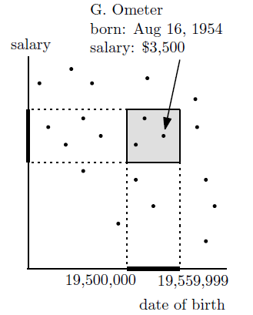
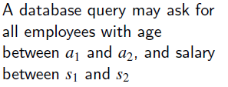
Example 1- Range Search in 2D
age = 10,000 x year + 100 x month + day

Slide 16
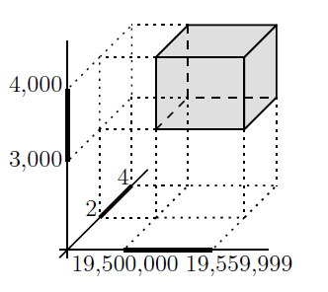
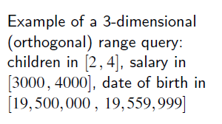
Example 2 – Range Search in 3D

Slide 17
Example 3 – Nearest Neighbors Search
QueryPoint

Slide 18
Nearest Neighbor Classification…
Data preprocessing is often required
Attributes may have to be scaled to prevent distance measures from being dominated by one of the attributes
Example:
height of a person may vary from 1.5m to 1.8m
weight of a person may vary from 90lb to 300lb
income of a person may vary from $10K to $1M
Time series are often standardized to have 0 means a standard deviation of 1

Slide 19
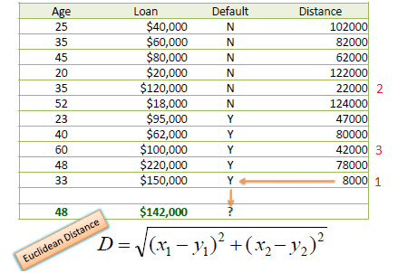

Slide 20
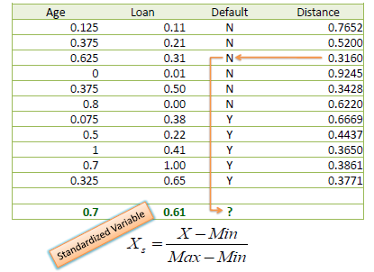
Need for Standardizing Attributes

Slide 21
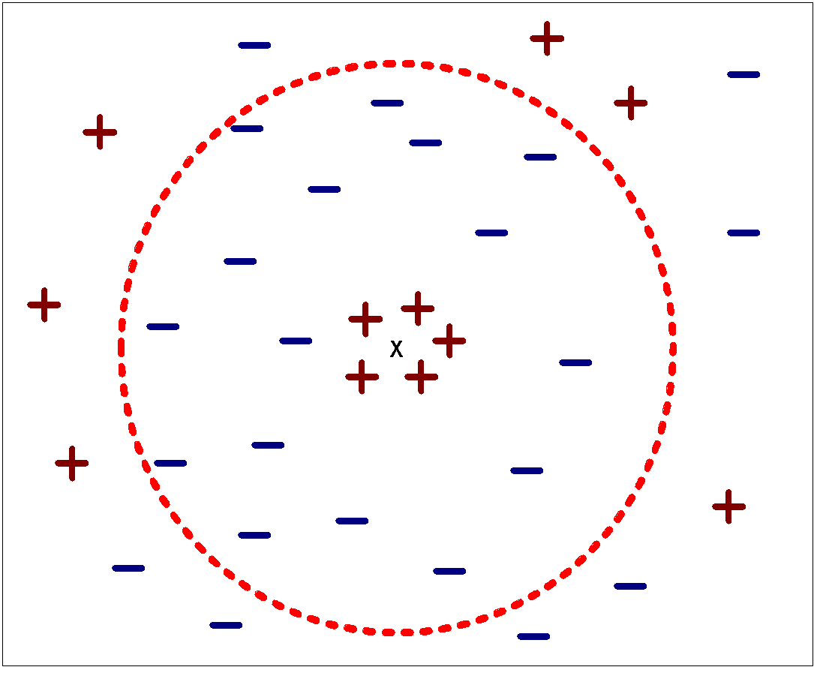
Nearest Neighbor Classification…
Choosing the value of k:
If k is too small, sensitive to noise points
If k is too large, neighborhood may include points from other classes

Slide 22
Nearest Neighbor Classification…
How to handle missing values in training and test sets?
Proximity computations normally require the presence of all attributes
Some approaches use the subset of attributes present in two instances
This may not produce good results since it effectively uses different proximity measures for each pair of instances
Thus, proximities are not comparable

Slide 23
Handling Irrelevant and Redundant Attributes
Irrelevant attributes add noise to the proximity measure
Redundant attributes bias the proximity measure towards certain attributes

Slide 24
Improving KNN Efficiency
Avoid having to compute distance to all objects in the training set
Multi-dimensional access methods (k-d trees)
Fast approximate similarity search
Locality Sensitive Hashing (LSH)
Condensing
Determine a smaller set of objects that give the same performance
Editing
Remove objects to improve efficiency

